Slide 1
VEHICLE COUNT PREDICTION USING GAN
CREATED BY
C . MAHALAKSHIMI
III-YEAR , CSE
REG.NO:912321104020
SACS MAVMM ENGINEERING COLLEGE

Slide 2
Project Agenda:
Problem statement
Proposed system/solution
System deployment approach
Algorithm and deployment
Result
conclution

Slide 3
Problem Statement:
Design and implement a Generative Adversarial Network (GAN) to predict vehicle counts in a given area based on historical data. The model should be able to generate realistic future scenarios of vehicle traffic, aiding in urban planning and traffic management. The prediction accuracy and reliability of the model must be maximized to support effective decision-making processes. Additionally, the system should provide insights into peak traffic hours and potential congestion areas, facilitating proactive measures for efficient transportation management.

Slide 4
Proposed system/solution:
Data Collection and Preprocessing:
Collect historical data on vehicle counts from various sources such as traffic cameras, sensors, or manual counts.
Preprocess the data by cleaning, normalizing, and formatting it for training the GAN.
GAN Architecture:
Design a GAN architecture suitable for generating vehicle count predictions.
Use a conditional GAN (cGAN) where the input is a set of parameters that influence vehicle counts (e.g., time of day, day of week, weather conditions, road type).
The generator network will produce synthetic vehicle count data based on these input parameters.
The discriminator network will distinguish between real and synthetic vehicle count data.

Slide 5
Proposed system/solution:(contd…)
3.Training:
Train the GAN on the preprocessed historical data.
Use techniques like mini-batch discrimination, feature matching, and label smoothing to stabilize training and improve the quality of generated samples.
Monitor the training process to ensure convergence and avoid mode collapse.
4.Evaluation:
Evaluate the trained GAN using validation data to assess its performance in generating realistic vehicle count predictions.
Metrics such as Mean Absolute Error (MAE), Mean Squared Error (MSE), and distribution similarity can be used for evaluation.
5.Generation and Prediction:
Once the GAN is trained and evaluated, it can be used to generate synthetic vehicle count predictions for future time periods.
Provide input parameters such as time of day, day of week, weather forecast, etc., to the generator network to generate corresponding vehicle count predictions.

Slide 6
Proposed system/solution:(contd…)
6.Integration and Deployment:
Integrate the GAN-based prediction system into existing traffic management systems or decision support tools.
Develop an API or interface for easy access to the prediction model.
Continuously update and retrain the GAN with new data to improve prediction accuracy over time.
7.Monitoring and Maintenance:
Regularly monitor the performance of the GAN-based prediction system in real-world scenarios.
Fine-tune the model as needed and address any issues that arise.
Keep track of changes in underlying data distributions and update the model accordingly.
8.Privacy and Ethical Considerations:
Ensure that privacy regulations are adhered to when collecting and using data for training the GAN.
Implement measures to prevent biases in the generated predictions.
Transparently communicate the limitations and uncertainties associated with the predictions to stakeholders.

Slide 7
System development approach:
Hardware Development:
Define Hardware Requirements:
Determine the computing power required for training and inference tasks.
Choose suitable GPUs or TPUs for accelerating GAN training.
Specify storage requirements for datasets and model checkpoints.
Setup Hardware Infrastructure:
Procure necessary hardware components based on defined requirements.
Set up a robust computing environment with sufficient cooling and power supply.
Configure network connectivity for data transfer and remote access.
Optimize Hardware Performance:
Overclock GPUs (if applicable) to maximize performance.
Implement parallel processing techniques to distribute computational load effectively.
Regularly monitor hardware health and performance metrics.

Slide 8
Software Development:
Data Collection and Preprocessing:
Gather vehicle count data from sensors, cameras, or existing databases.
Preprocess the data to remove noise, normalize features, and handle missing values.
Model Selection:
Choose appropriate GAN architecture for the task, considering factors like image resolution, stability, and computational efficiency.
Experiment with variations of GAN models such as DCGAN, WGAN, or conditional GANs depending on specific requirements.
Training Pipeline:
Implement a training pipeline to feed preprocessed data into the GAN model.
Configure training hyperparameters including learning rate, batch size, and optimization algorithms.
Monitor training progress and adjust parameters as necessary to ensure convergence.

Slide 9
Software Development:(conts)
4.Evaluation and Validation:
Evaluate the trained model using validation datasets to assess its performance in predicting vehicle counts accurately.
Measure metrics such as Mean Absolute Error (MAE) or Root Mean Square Error (RMSE) to quantify prediction accuracy.
Validate the model against real-world scenarios and fine-tune if necessary.
5.Deployment:
Integrate the trained GAN model into a production environment.
Develop APIs or interfaces for seamless interaction with other systems or applications.
Implement robust error handling and logging mechanisms for monitoring system performance in real-time.
6.Maintenance and Updates:
Establish a schedule for regular maintenance tasks such as model retraining, software updates, and hardware upgrades.
Continuously monitor system performance and user feedback to identify areas for improvement.
Stay updated with advancements in GAN research and implement relevant improvements to the system.

Slide 10
Algorithm and deployment:
Algorithm steps:
Data Collection:
Gather video footage or images from traffic cameras or other sources.
Annotate the data to label vehicles and count them.
Preprocessing:
Convert the video footage into frames or extract relevant images.
Resize and normalize images.
Split data into training and validation sets.

Slide 11
Algorithm steps:(contd…)
3.GAN Model Training:
Define a GAN architecture suitable for generating synthetic traffic scenes.
Train the GAN using real traffic images to generate synthetic images with varying traffic densities.
Use a discriminator network to distinguish between real and synthetic images.
Optimize both generator and discriminator networks using adversarial training.
4.Vehicle Count Prediction Model:
Utilize a separate model (e.g., CNN, RNN, or CNN-RNN hybrid) to predict vehicle counts.
Train this model using both real and synthetic images along with their corresponding vehicle counts.
Use techniques like transfer learning if necessary.
5.Deployment:
Choose a deployment environment (e.g., cloud, edge device) based on computational requirements and real-time constraints.
Containerize the model and associated components for easier deployment and scalability.

Slide 12
Deployment :
Scalability: Ensure the system can handle varying loads of incoming traffic data.
Real-time Performance: Optimize inference speed for real-time predictions, especially if deployed in traffic management systems.
Security: Implement authentication and authorization mechanisms to protect the deployed system from unauthorized access.
Resource Management: Monitor resource utilization and scale resources dynamically based on demand to maintain performance.
Error Handling: Implement robust error handling mechanisms to handle failures gracefully.
Versioning: Maintain version control for models and associated components to track changes and rollback if necessary.
Regulatory Compliance: Ensure compliance with relevant regulations and standards, especially regarding data privacy and security.
Documentation: Document the deployment process, including dependencies and configurations, for easier maintenance and troubleshooting.

Slide 13
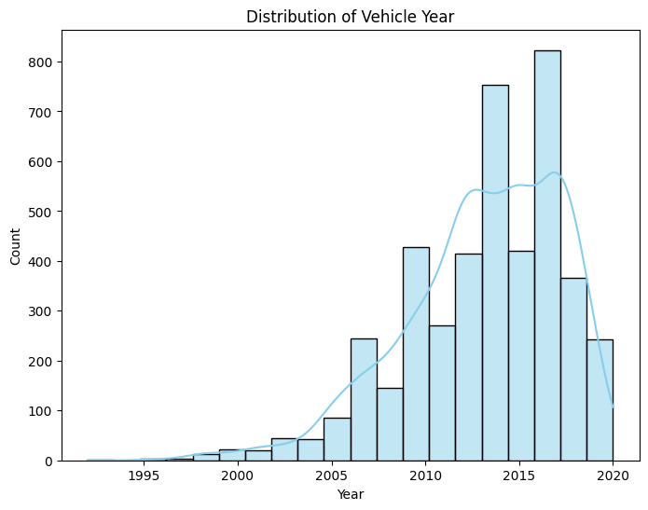
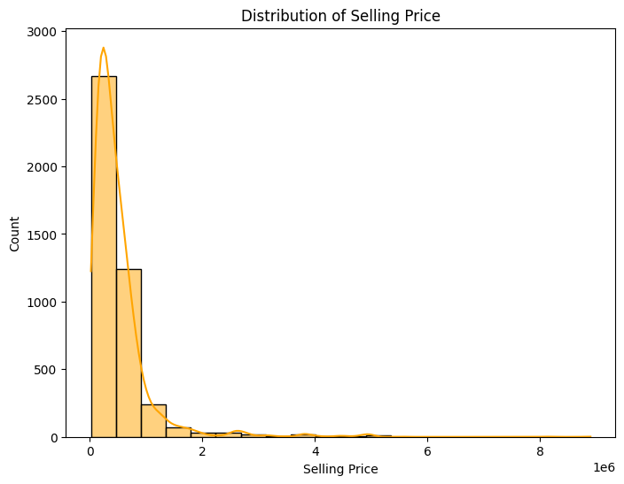
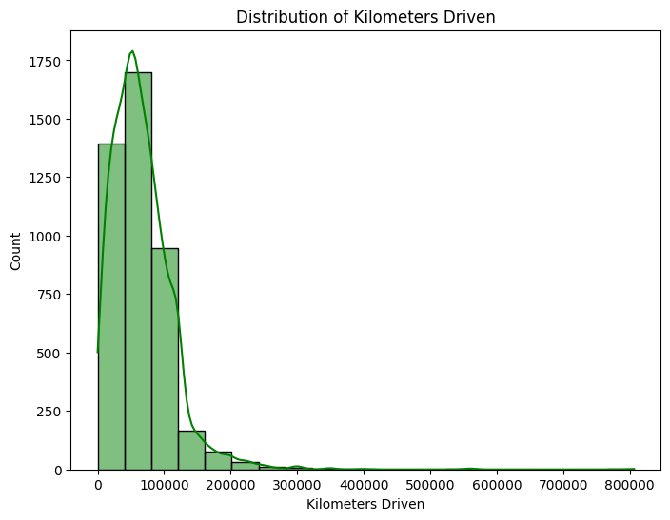
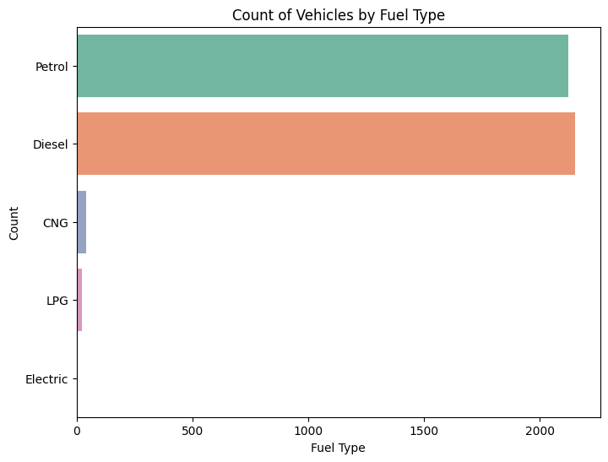
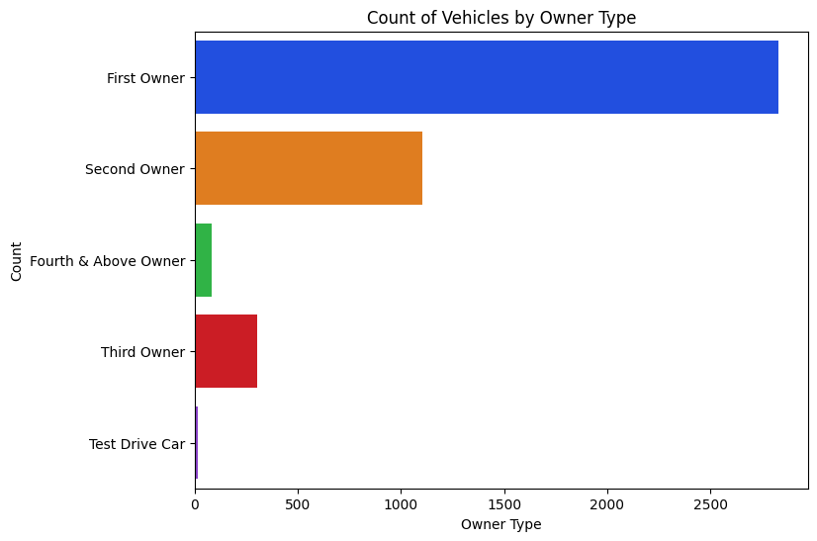
Result:

Slide 14
References:
https://www.tensorflow.org/
https://numpy.org/
https://scikit-learn.org/stable/
https://keras.io/
https://matplotlib.org/
https://www.kaggle.com/datasets/uciml/sms-spam-collection-dataset

Slide 15
Conclution:
Employing GANs for vehicle count prediction offers a promising approach to accurately forecast vehicle counts in various scenarios, aiding in traffic management, urban planning, and transportation optimization. By leveraging the power of deep learning and adversarial training, GANs can generate realistic predictions that can inform decision-making processes and enhance efficiency in transportation systems.

Slide 16
Thank you

